Slide 1

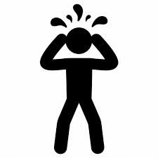
Oxytocin receptor genetic variation relates to empathy and stress reactivity in humans
2009
Sarina M. Rodrigues
Laura R. Saslow
Natalia Garcia
Oliver P. John
Dacher Keltnerc

Slide 2

Introduction
Oxytocin is a peptide that functions as a hormone and a neurotransmitter.
It has broad influences on social and emotional processing throughout the body and the brain.
This paper focuses on how a polymorphism (rs53576) of the oxytocin receptor relates to two key social processes associated with oxytocin: empathy and stress reactivity.
rs53576 is a silent G to A change in the oxytocin receptor (OXTR) gene.
The A (minor) allele of rs53576 has been associated with impaired social and maternal behaviors, while the G allele has been associated with greater sociality in people.

Slide 3

Hypotheses
Oxytocin supports affiliative behavior
Generosity
Trust
Eye gaze
The ability to infer the affective mental states of others
Parent–child bonding behaviors
Feelings of romantic love and trust
Empathy and subsequent generosity toward strangers
Oxytocin interacts with the hypothalamo-pituitary-adrenal axis to attenuate the stress response
Decreasing cortisol levels
Inhibiting cardiovascular responses to stress
Attenuating amygdala responsivity to emotional stimuli

Slide 4

Methods

Slide 5
Genotyping
Participants included college students at the University of California, Berkeley (n = 192, 59% female) with a mean age of 20.2 years (SE = 0.20 years) and of mixed ethnicity (35% Caucasian, 41% Asian, and 24% other or multiple ethnicities) participated in the study for partial course credit.
DNA was collected from saliva and the samples were prepared for the genotyping of the SNP marker for rs53576.
The following tests then followed:

Slide 6
Test For Empathy
The behavioral measure of empathic accuracy was assessed by giving participants the “Reading the Mind in the Eyes” Test (RMET), which tests for the empathic ability to infer the emotional states of others. (https://s3.amazonaws.com/he-assets-prod/interactives/233_reading_the_mind_through_eyes/Launch.html)
A well-validated 21-item self-report scale that reflects the core facets of other-oriented empathic behavior was used to assess dispositional empathy (The Davis Interpersonal Reactivity Index). The core facets include perspective taking, empathic concern, and fantasy.

Slide 7
Test For Stress Reactivity
Physiological Task:
  Participants heart rate(HR) was taken in a paced-breathing task. They were then presented initially with an unanticipated white-noise burst startle stimulus. After this, to potentiate stress reactivity, they were told that they were going to hear the loud noise two more times at the end of a 20-second countdown. An index of HR reactivity was then averaged and compared with the baseline HR during the paced-breathing task.
A 12-item scale that captures affective reactivity to stressful situations, emergencies, and crises, rather than baseline negative affect was used to assess dispositional levels of stress reactivity. The scale had a highly reactive end (eg. Feeling unease under stress) and a low reactive end (eg. Being calm under stress).

Slide 8


For Attachment Style And Received Parental Care
A discriminant validity test on whether the rs53576 variation would relate to self-report measures of attachment style and received parental care was also taken.
For the attachment style, a shortened version of the Experiences in Close Relationships Inventory was used. It measures the two major dimensions of attachment functioning in adults: attachment avoidance and attachment anxiety
Using the caring scale of the Parental Bonding Instrument, participants rated their father's and their mother's caregiving behavior before the participants' age of 16.

Slide 9

Story! Story!

Slide 10
https://youtu.be/q1a7tiA1Qzo
Do you ever wonder why you react to a touching movie?
Do you ever wonder why you offer money to a stranger who comes to you asking for money to buy food?
Oxytocin and empathy are correlated.
Emotionally engaging narratives inspire post-narrative actions.

Slide 11

Results

Slide 12
Oxytocin had been proposed to evolve to influence social and stress profiles of males and females differently, but this research verified that there were no significant interactions of rs53576 with gender.
In all but one of their measures, the AA and AG groups did not differ in statistically significant ways; and were therefore combined in comparative analyses to GG, as done previously by other researchers.

Slide 13
GG individuals performed significantly better on the behavioral measure of empathy (Fig. 1A), being 22.7% less likely to make a mistake on the RMET than AA/AG individuals.
GG individuals reported higher levels of dispositional empathy than AA/AG individuals (Fig. 1B).
GG individuals scored significantly lower on HR reactivity to the startle anticipation than AG/AA individuals (Fig. 2A).
GG individuals reported lower levels of dispositional stress reactivity (Fig. 2B).
GG individuals did not differ from AG/AA individuals on either.
GG individuals did not differ from AG/AA individuals on received.

Slide 14
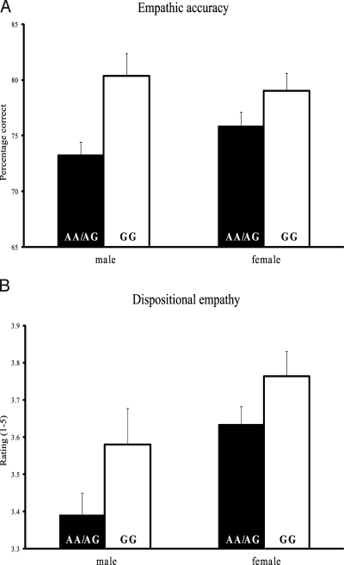
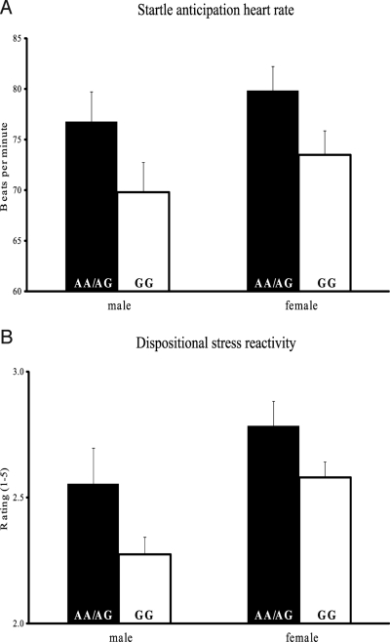
FOR EMPATHY
FOR STRESS REACTIVITY

Slide 15

Discussion

Slide 16
This study demonstrates a link between OXTR variations and individual differences in empathy and stress-related profiles.
In the present research, those individuals who are homozygous for the G allele, compared to those with one or two copies of the A allele, proved to be more adept at inferring the mental states of others and also reported experiencing higher levels of empathy.
Complementing these findings, those with an A allele showed greater cardiovascular reactivity to an imminent startle probe and also reported higher levels of reactivity across a variety of stressful contexts.
These findings have important implications for understanding how naturally occurring variations in the oxytocin system, which can influence neural and physiological processing, affect both social and emotional systems.

Slide 17
What I did not understand about the paper
The essence of the attachment and parental care tests.

Slide 18



